Slide 1
Identifying the Price Gap at Big Mountain Resort
Jared Thompson

Slide 2
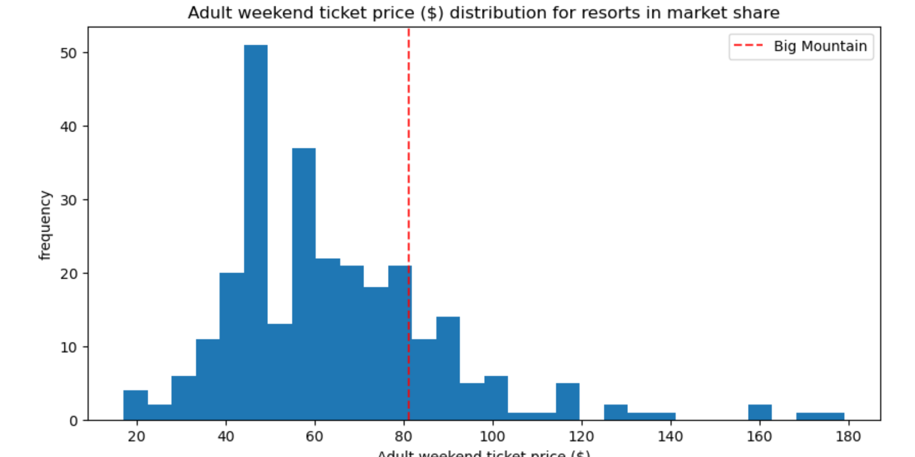
Problem Identification
Notes:
Big Mount

Slide 3
Problem Identification
Big Mountain Resort current t ticket price is $81
Resort Management suspects pricing might not fully reflect market value based on facilities
Objective: Use data driven insight to determine if ticket price can be adjusted to better match market position and customer expectation.

Slide 4
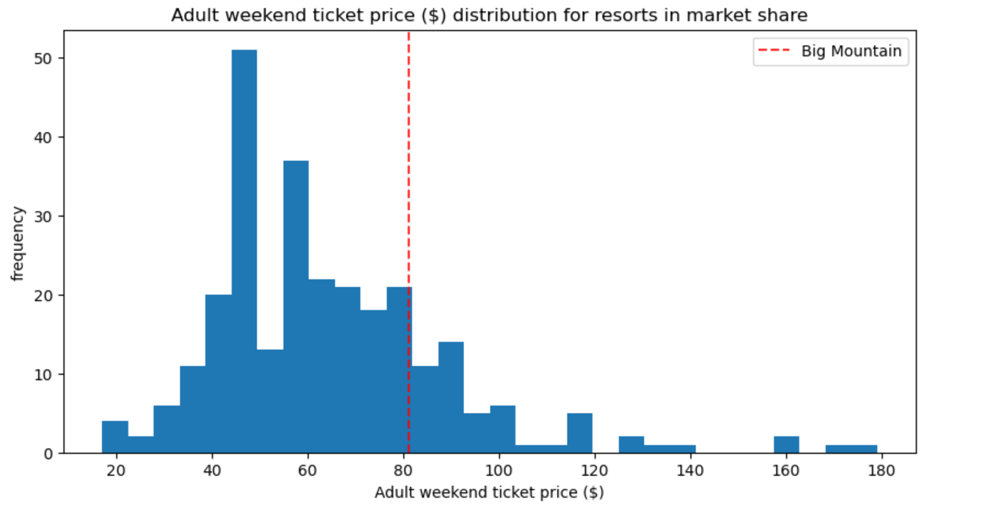
Recommendation and Key Findings
Model suggest that Big Mountains facilities support a ticket price of $99.88
Recommendation: Incrementally raise prices to capture more revenue while ensuring alignment with willing to improve facilities
Scenario 2: Increasing Vertical drop and adding a chair lift would increase revenue potential.

Slide 5
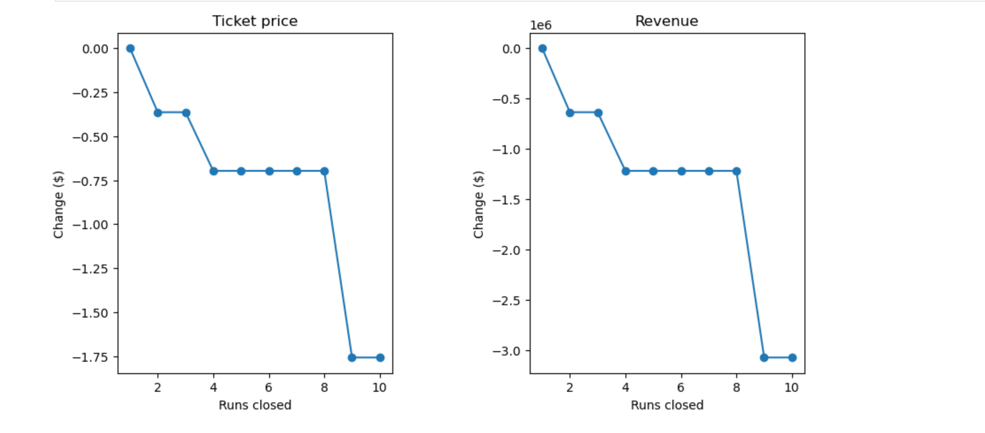
Scenario 1: Impact of Closing Runs
Closing 2-3 runs reducess ticket price only slightly (By less than $1), but closing 6 or more runs lowers the supported ticket price.
Recommendation: Close 3 runs to save cost without a significant impact on revenue

Slide 6
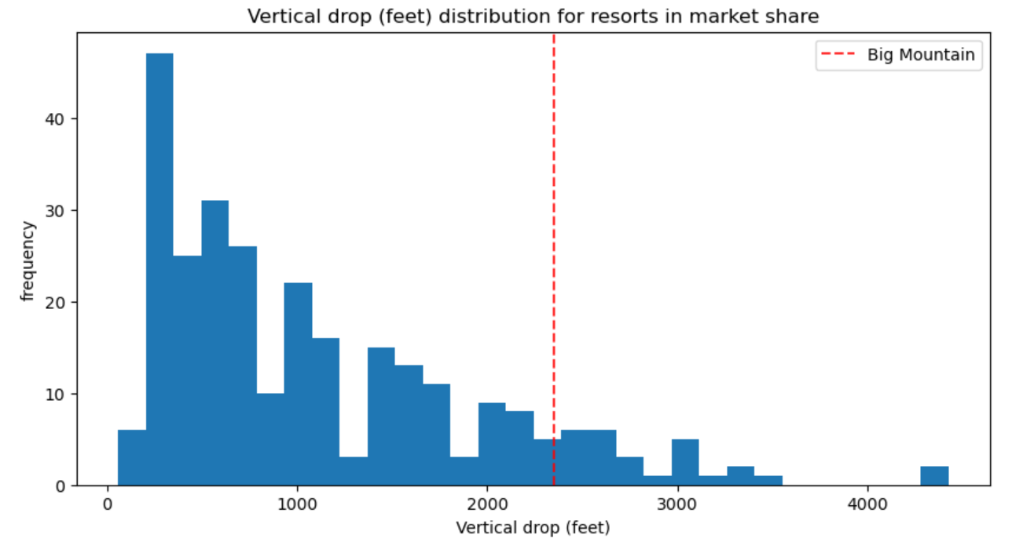
Scenario 2: Increasing Vertical Drop and Adding a Chair Lift
Increasing the vertical drop by 150 feet and adding a chair lift would increase ticket prices by $1.99, with a potential revenue increase of $3.47 million for the season.
Recommendation: Proceed with this option as it provides the highest revenue potential.

Slide 7
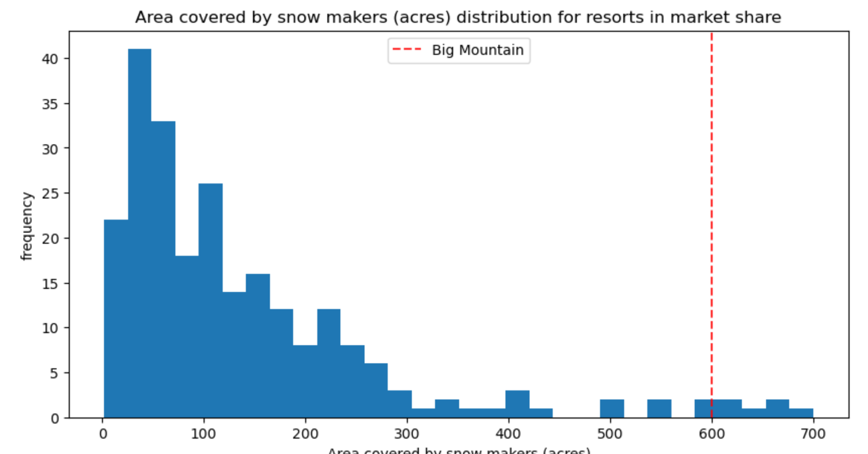
Scenario 3: Adding Snowmaking Coverage
Adding 2 acres of snowmaking in addition to Scenario 2 does not significantly increase the ticket price.
Recommendation: Prioritize vertical drop and chair lift expansion over snowmaking.

Slide 8
Summary and Conclusion
Big Mountain Resort can support a higher ticket price of $99.88 based on its facilities.
Scenario 2 (vertical drop and chair lift expansion) offers the best potential for further increasing the ticket price by $1.99, translating into significant revenue gains.
Management should consider incremental pricing changes, closing non-essential runs, and capital investments in key infrastructure to drive future revenue.

